Slide 1
App Design in 21 minutes
Just the very basics.

Slide 2
Problem Solving
Design is about:
Communication
Creating Interest
Solving Problems
Visual or Design Element:
Anything on the page as well as the lack of anything (space).
Images, text, lines, shapes, graphics, spacing, etc.

Slide 3
CRAP Design
C.R.A.P:
Contrast
Repetition
Alignment
Proximity

Slide 4
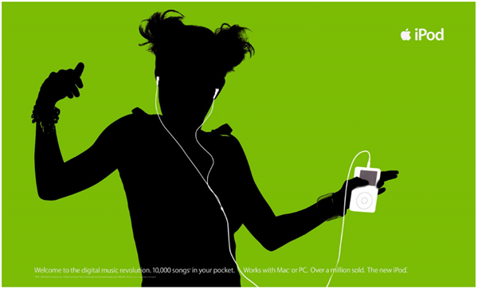

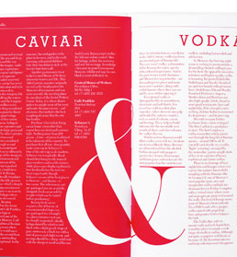
Contrast
Use colors, shapes, sizes, fonts, space and imagery to create contrast in design.
Avoid colors and typefaces that are similar.

Slide 5
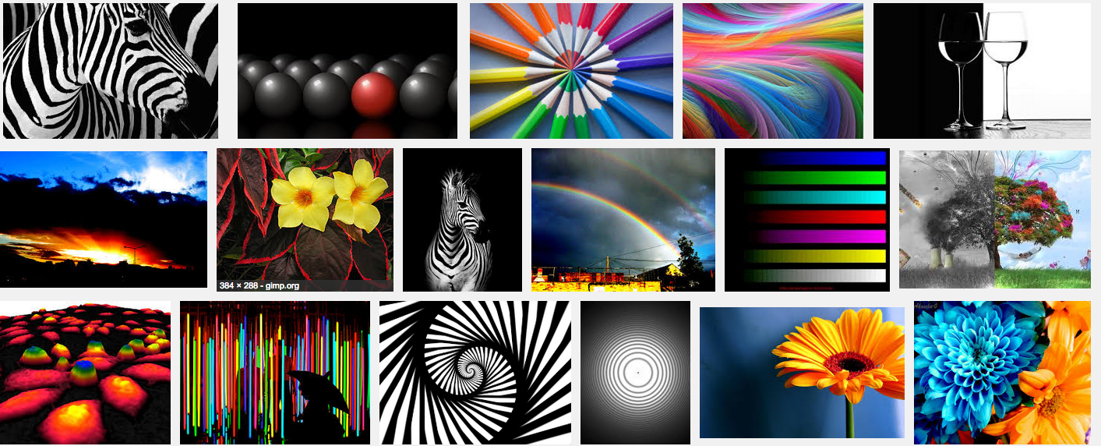
Contrast Examples
Think Differences

Slide 6
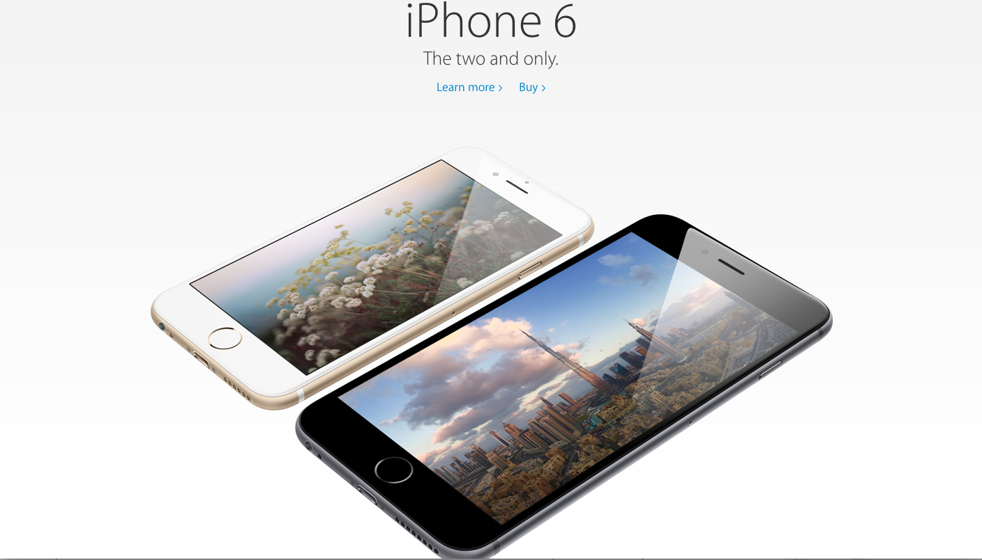

Slide 7
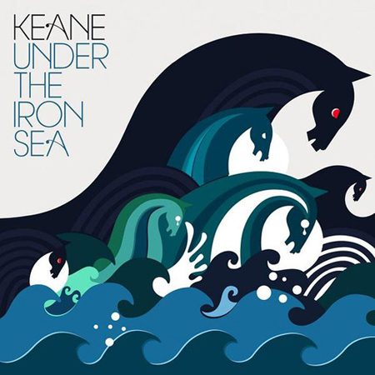
Repetition
Repeat visual elements throughout the design
Communicates consistency and brand

Slide 8
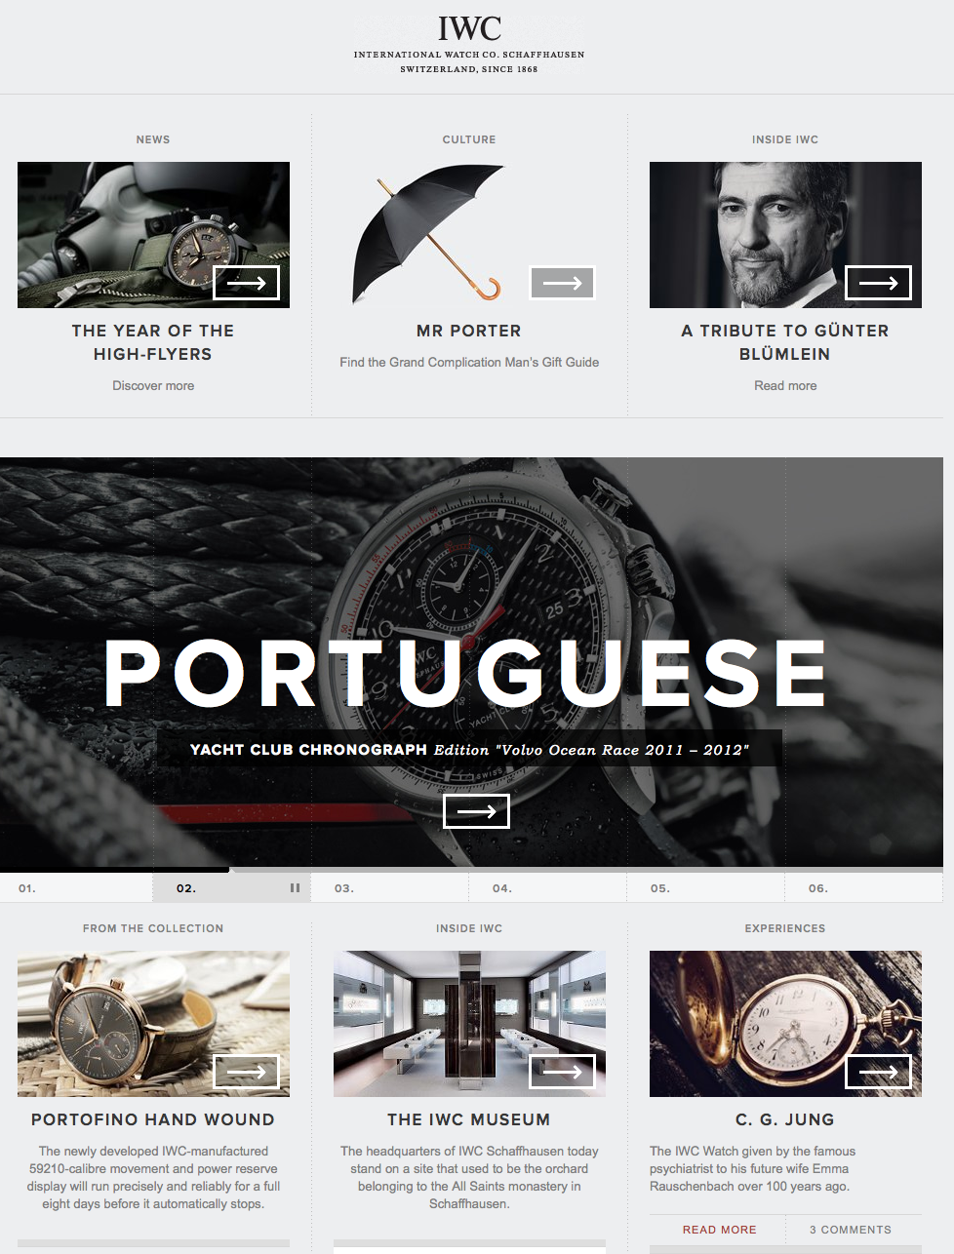

Slide 9
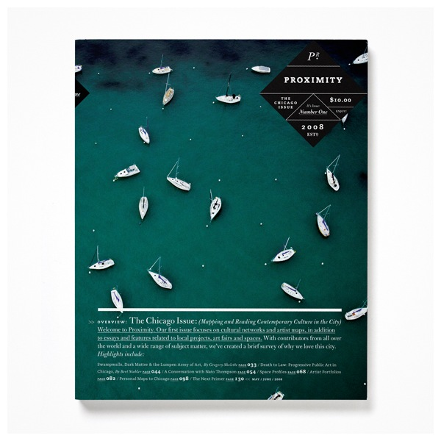

Alignment
Where’s my boat?
Dock 4, Slip 20.

Slide 10
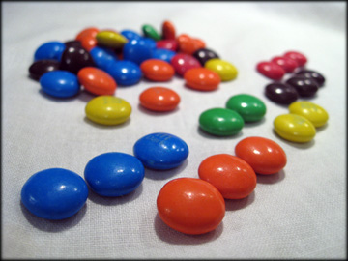

Proximity
Similar Items Closer, Different farther apart.

Slide 11
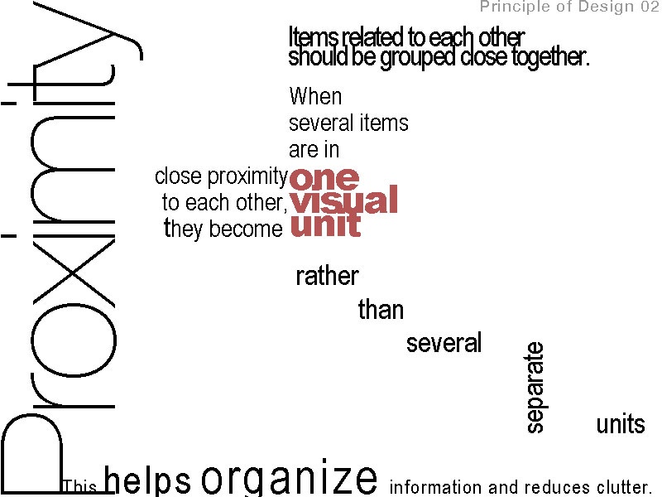

Slide 12
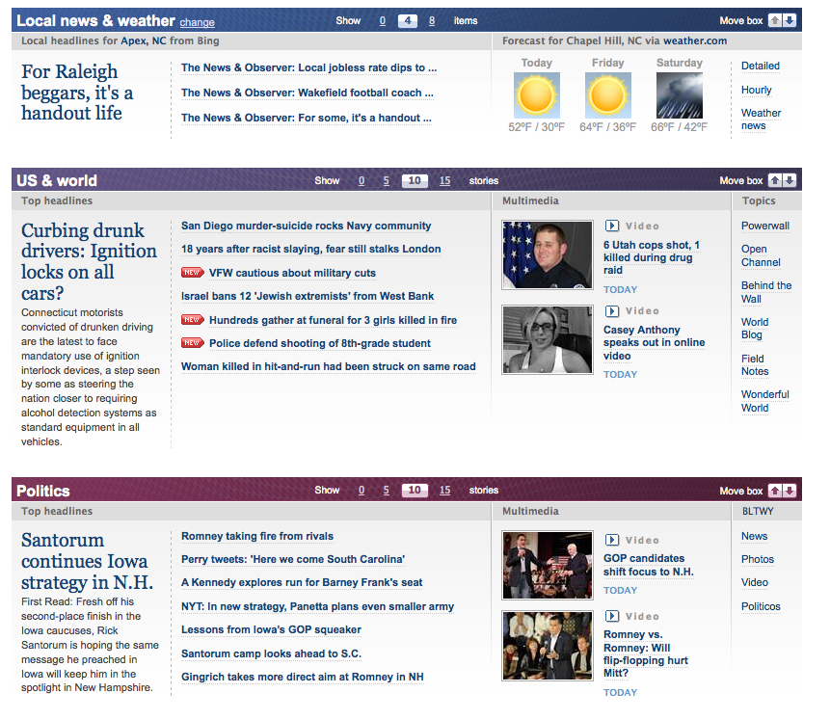

Slide 13

Color

Slide 14
CMYK or RGB?
CMYK
RGB
For Print
Pigment
DO NOT USE IN CLASS!
For Screens
Light
ALWAYS USE IN CLASS!
WE WILL NEVER USE OR SPEAK OF CMYK IN THIS CLASS AGAIN!

Slide 15
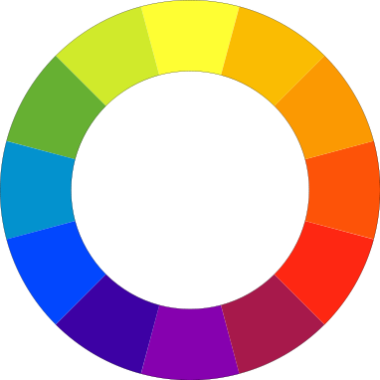
Color Wheel

Slide 16
Color Scheme Selection
http://kuler.adobe.com/#themes/rating?time=30
http://colorschemedesigner.com/
Image Selection in Photoshop

Slide 17
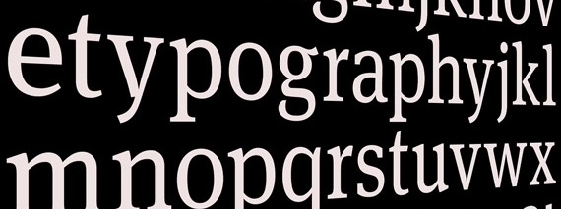
Design: Type
Readability
Relationships
Types of Type (Fonts
Type on the web

Slide 18
Readability
Type has multiple purposes but the most important is readability. The ability for a reader to easily read and understand the text.
Contributors/Distractors
Size, color, texture, light, font, weight, relationship etc.

Slide 19
Conflicting
When you combine type faces that are similar but not the same. This makes the page less interesting because it is not concordant.
Times New Roman
&
Palatino

Slide 20

Contrasting
When you combine separate typefaces that are distinct and different from each other. The best designs have contrast and this includes font.

Slide 21
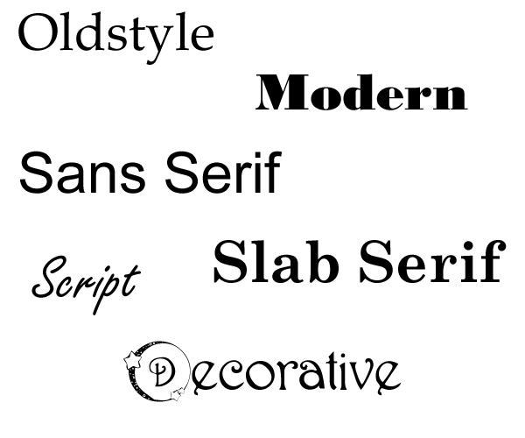
Type Categories
Remember them in groups of two:
Old/Modern, Serif/Sans, Script/Decorative

Slide 22
My Rules
Never use more than three fonts and two is probably enough
Never use more than one serif font
Never use more than one san serif font
Never use more than one decorative font and only in limited doses
Typically, I choose one Serif, one san and call it a style!

Slide 23
Must Haves
Color: https://kuler.adobe.com
Fonts: http://www.fontsquirrel.com/
Font Combos: http://ifontyou.com/
Icons: http://fontawesome.io/
http://fortawesome.github.io/Font-Awesome/cheatsheet/
Wireframing: https://github.com/blakeperdue/ios7-wireframe-kit

Slide 24

Facebook App

Slide 25
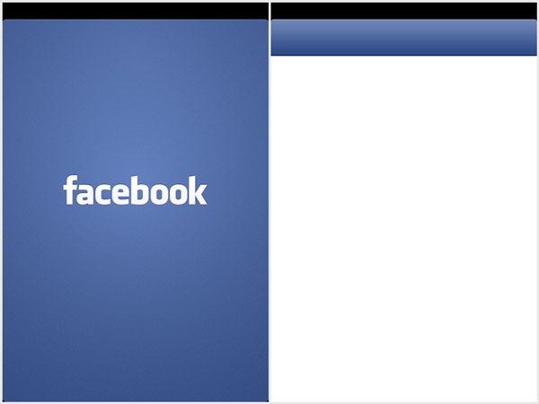
Performance vs. Perceived Performance

Slide 26
Cache
Thumbnails Scaled
Cache of News feed
Cache of Status on previous pages.

Slide 27
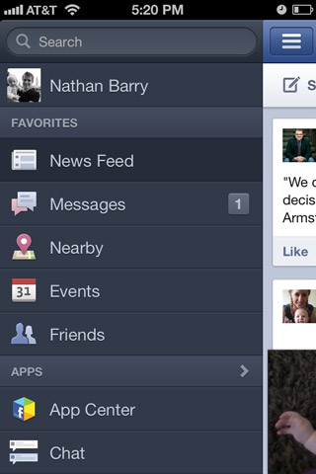
Speed

Slide 28
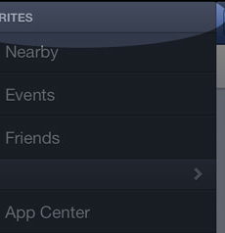
Usability Changes
New Menu Dividers
Message: “New Stories”

Slide 29
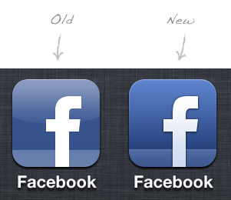
Design Changes
Modernized buttons
Brighter color blue
Raised/Depth txt/btns

Slide 30
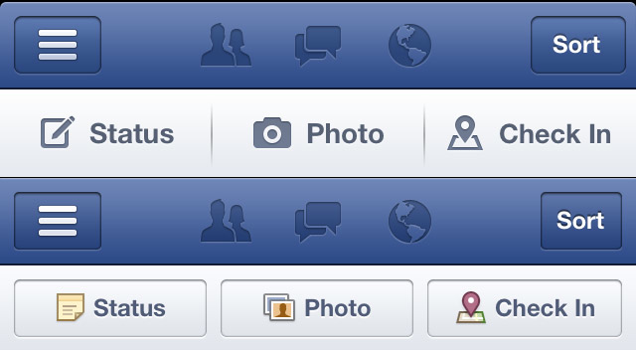
New Buttons
Does a button need a visually defined area.

Slide 31
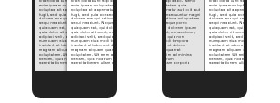
Different Sliding animation
Communicates you have not left the previous content, it is just moved over.

Slide 32
Your Apps!

